Slide 1
CS 335 Computer Networks
Dr. JingTao Yao
Office: CW308.18
Email: jtyao@cs.uregina.ca
Office hours:
Mon & Wed: 2:30 pm – 3:45 pm
or by appointment

Slide 2

CS335
Computer Networks
Introduction 1
Computer Networking: A Top Down Approach 6th edition Jim Kurose, Keith Ross Addison-Wesley March 2012

Slide 3
Chapter 1: introduction
our goal:
get “feel” and terminology
more depth, detail later in course
approach:
use Internet as example
overview:
what’s the Internet?
what’s a protocol?
network edge; hosts, access net, physical media
network core: packet/circuit switching, Internet structure
performance: loss, delay, throughput
security
protocol layers, service models
history

Slide 4
Chapter 1: roadmap
1.1 what is the Internet?
1.2 network edge
end systems, access networks, links
1.3 network core
packet switching, circuit switching, network structure
1.4 delay, loss, throughput in networks
1.5 protocol layers, service models
1.6 networks under attack: security
1.7 history

Slide 5



















What’s the Internet: “nuts and bolts” view
PC
millions of connected computing devices:
hosts = end systems
running network apps
mobile network
server
wireless
laptop
global ISP
smartphone
home
network
communication links
fiber, copper, radio, satellite
transmission rate: bandwidth
regional ISP
wireless
links
wired
links
Packet switches: forward packets (chunks of data)
routers and switches
router
institutional
network
Notes:
5

Slide 6
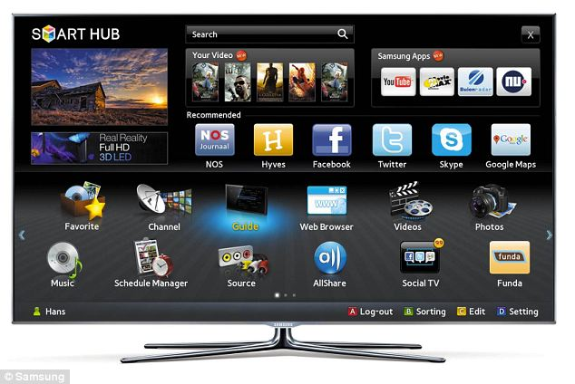





“Fun” internet appliances
Web-enabled toaster +
weather forecaster
Smart TV
IP picture frame
http://www.ceiva.com/
Tweet-a-watt:
monitor energy use
Slingbox: watch,
control cable TV remotely
Internet
refrigerator
Internet phones

Slide 7
What’s the Internet: “nuts and bolts” view
Internet: “network of networks”
Interconnected ISPs
protocols control sending, receiving of msgs
e.g., TCP, IP, HTTP, Skype, 802.11
Internet standards
RFC: Request for comments
IETF: Internet Engineering Task Force
mobile network
global ISP
home
network
regional ISP
institutional
network

Slide 8
What’s the Internet: a service view
mobile network
Infrastructure that provides services to applications:
Web, VoIP, email, games, e-commerce, social nets, …
provides programming interface to apps
hooks that allow sending and receiving app programs to “connect” to Internet
provides service options, analogous to postal service
global ISP
home
network
regional ISP
institutional
network

Slide 9
What’s a protocol?
human protocols:
“what’s the time?”
“I have a question”
introductions
… specific msgs sent
… specific actions taken when msgs received, or other events
network protocols:
machines rather than humans
all communication activity in Internet governed by protocols
protocols define format, order of msgs sent and received among network entities, and actions taken on msg transmission, receipt

Slide 10



What’s a protocol?
a human protocol and a computer network protocol:
Hi
TCP connection
request
Hi
TCP connection
response
Got the
time?
Get http://www.awl.com/kurose-ross
2:00
<file>
time
Q: other human protocols?

Slide 11
Chapter 1: roadmap
1.1 what is the Internet?
1.2 network edge
end systems, access networks, links
1.3 network core
packet switching, circuit switching, network structure
1.4 delay, loss, throughput in networks
1.5 protocol layers, service models
1.6 networks under attack: security
1.7 history
Notes:
11

Slide 12


A closer look at network structure:
network edge:
hosts: clients and servers
servers often in data centers
mobile network
global ISP
access networks, physical media: wired, wireless communication links
home
network
regional ISP
network core:
interconnected routers
network of networks
institutional
network

Slide 13

Access networks and physical media
Q: How to connect end systems to edge router?
residential access nets
institutional access networks (school, company)
mobile access networks
keep in mind:
bandwidth (bits per second) of access network?
shared or dedicated?

Slide 14

Access net: digital subscriber line (DSL)
central office
telephone
network
DSL
modem
splitter
DSLAM
ISP
voice, data transmitted
at different frequencies over
dedicated line to central office
DSL access
multiplexer
use existing telephone line to central office DSLAM
data over DSL phone line goes to Internet
voice over DSL phone line goes to telephone net
< 2.5 Mbps upstream transmission rate (typically < 1 Mbps)
< 24 Mbps downstream transmission rate (typically < 10 Mbps)

Slide 15

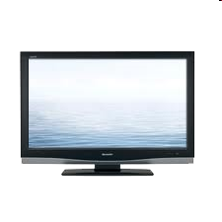


Access net: cable network
cable headend
…
cable
modem
splitter
C
O
N
T
R
O
L
V
I
D
E
O
V
I
D
E
O
V
I
D
E
O
V
I
D
E
O
V
I
D
E
O
V
I
D
E
O
D
A
T
A
D
A
T
A
1
2
3
4
5
6
7
8
9
Channels
frequency division multiplexing: different channels transmitted
in different frequency bands

Slide 16
Access net: cable network
cable headend
…
cable
modem
splitter
CMTS
cable modem
termination system
data, TV transmitted at different
frequencies over shared cable
distribution network
ISP
HFC: hybrid fiber coax
asymmetric: up to 30Mbps downstream transmission rate, 2 Mbps upstream transmission rate
network of cable, fiber attaches homes to ISP router
homes share access network to cable headend
unlike DSL, which has dedicated access to central office

Slide 17





Access net: home network
wireless
devices
to/from headend or central office
often combined
in single box
cable or DSL modem
wireless access
point (54 Mbps)
router, firewall, NAT
wired Ethernet (100 Mbps)

Slide 18









Enterprise access networks (Ethernet)
institutional link to
ISP (Internet)
institutional router
Ethernet
switch
institutional mail,
web servers
typically used in companies, universities, etc
10 Mbps, 100Mbps, 1Gbps, 10Gbps transmission rates
today, end systems typically connect into Ethernet switch

Slide 19








Wireless access networks
shared wireless access network connects end system to router
via base station aka “access point”
wide-area wireless access
provided by telco (cellular) operator, 10’s km
between 1 and 10 Mbps
3G, 4G: LTE
wireless LANs:
within building (100 ft)
802.11b/g (WiFi): 11, 54 Mbps transmission rate
to Internet
to Internet

Slide 20

Host: sends packets of data
host sending function:
takes application message
breaks into smaller chunks, known as packets, of length L bits
transmits packet into access network at transmission rate R
link transmission rate, aka link capacity, aka link bandwidth
two packets,
L bits each
2
1
R: link transmission rate
host
packet
transmission
delay
time needed to
transmit L-bit
packet into link
L (bits)
R (bits/sec)
=
=

Slide 21
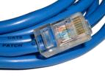
Physical media
bit: propagates between transmitter/receiver pairs
physical link: what lies between transmitter & receiver
guided media:
signals propagate in solid media: copper, fiber, coax
unguided media:
signals propagate freely, e.g., radio
twisted pair (TP)
two insulated copper wires
Category 5: 100 Mbps, 1 Gpbs Ethernet
Category 6: 10Gbps

Slide 22


Physical media: coax, fiber
coaxial cable:
two concentric copper conductors
bidirectional
broadband:
multiple channels on cable
HFC
fiber optic cable:
glass fiber carrying light pulses, each pulse a bit
high-speed operation:
high-speed point-to-point transmission (e.g., 10’s-100’s Gpbs transmission rate)
low error rate:
repeaters spaced far apart
immune to electromagnetic noise

Slide 23

The Nobel Prize in Physics 2009
Sir Charles Kuen Kao 高锟 for groundbreaking achievements concerning the transmission of light in fibers for optical communication
½ of the prize
shared with Willard S. Boyle and George E. Smith for the invention of an imaging semiconductor circuit – the CCD sensor

Slide 24
Physical media: radio
signal carried in electromagnetic spectrum
no physical “wire”
bidirectional
propagation environment effects:
reflection
obstruction by objects
interference
radio link types:
terrestrial microwave
e.g. up to 45 Mbps channels
LAN (e.g., WiFi)
11Mbps, 54 Mbps
wide-area (e.g., cellular)
3G cellular: ~ few Mbps
satellite
Kbps to 45Mbps channel (or multiple smaller channels)
270 msec end-end delay
geosynchronous versus low altitude

Slide 25
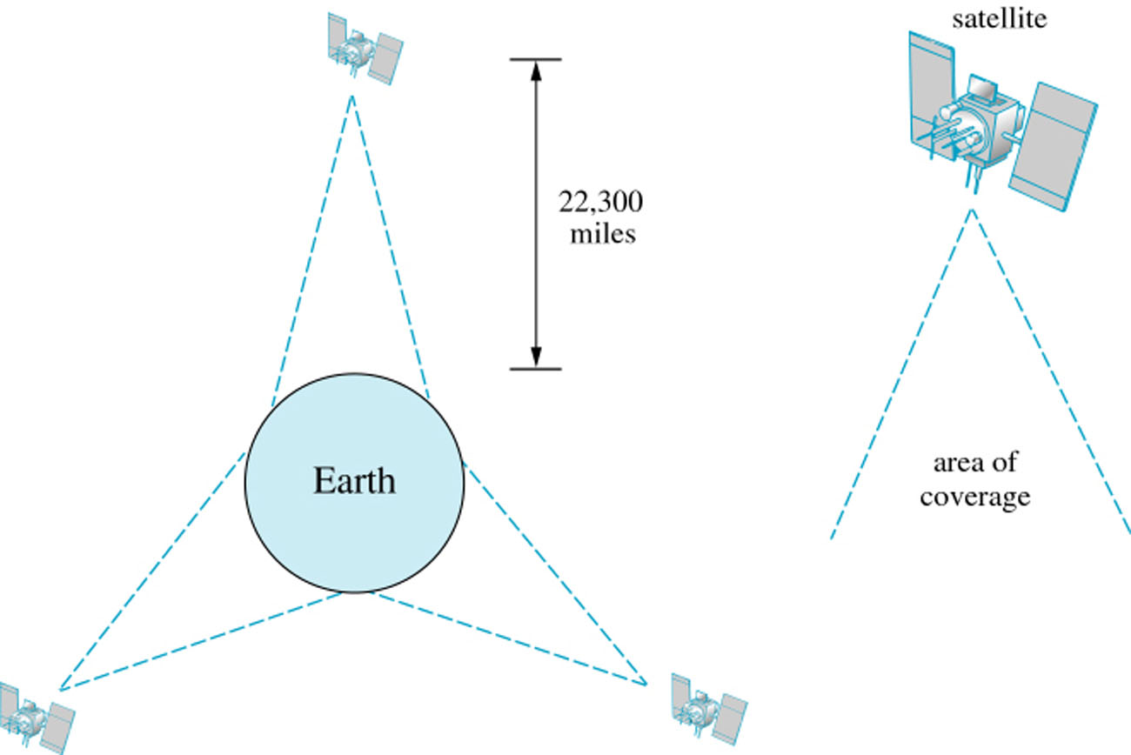
Satellite in Geosynchronous Orbit above the Equator
Three satellites will cover the whole world

Slide 26
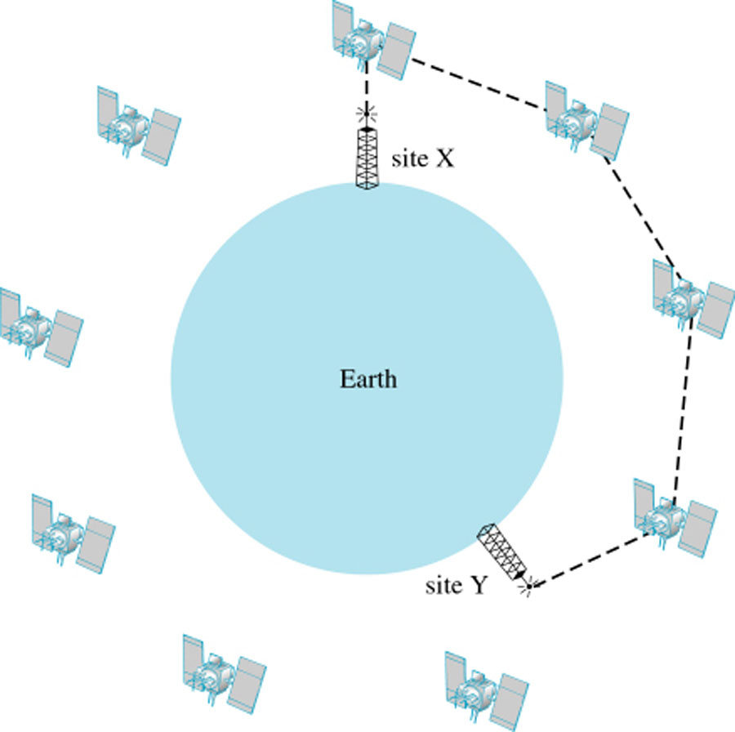
Signal Relay via Low Earth Orbit (LEO) Satellites
77 LEO satellites to form a global network
Iridium (77th element in the periodic table)

